Slide 1

Project Quack
Presented by
The Bestagons
Notes:
@Miles

Slide 2
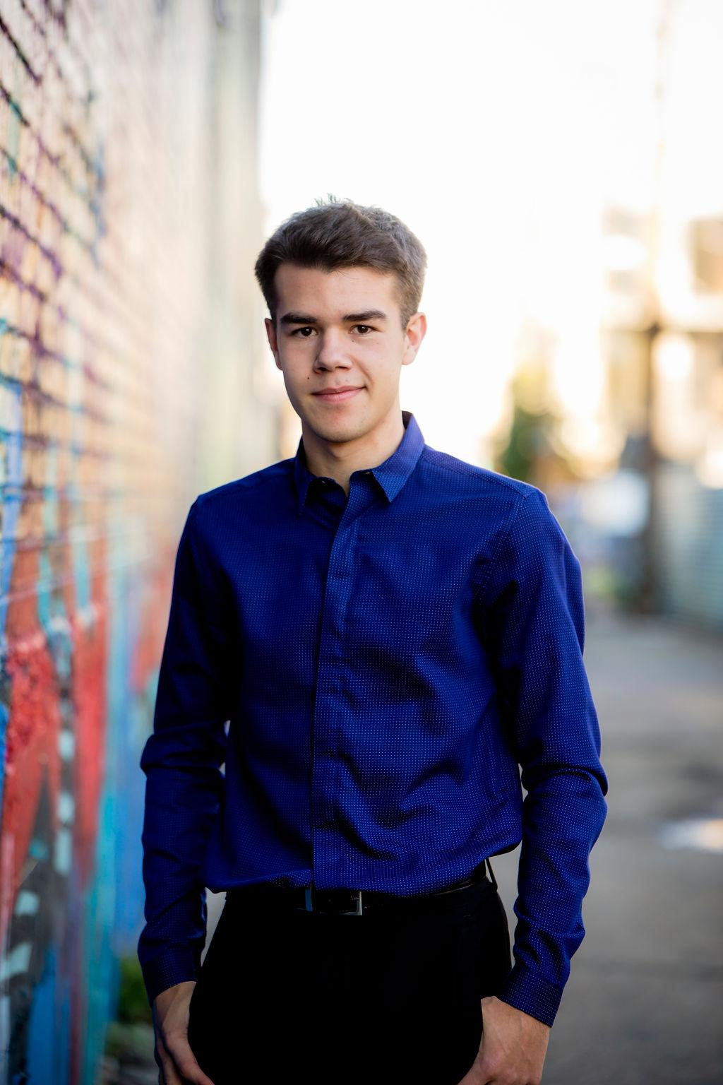

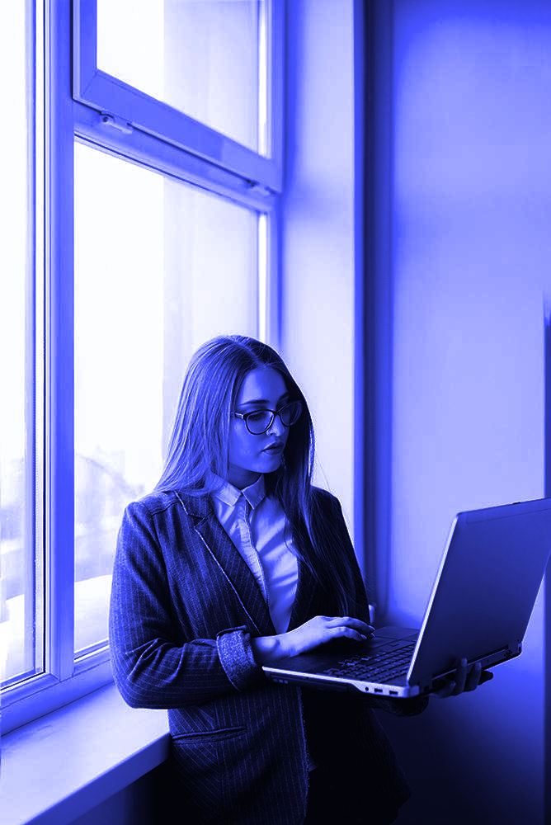
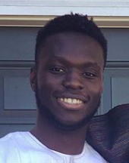
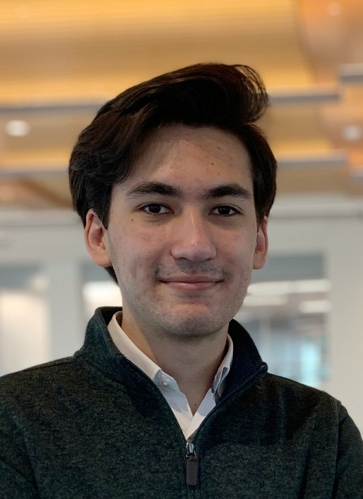
OUR TEAM
Ore Adenikinju
Miles Robertson
Rafael Piloto
Team member
Product Owner
Scrum Master

Slide 3
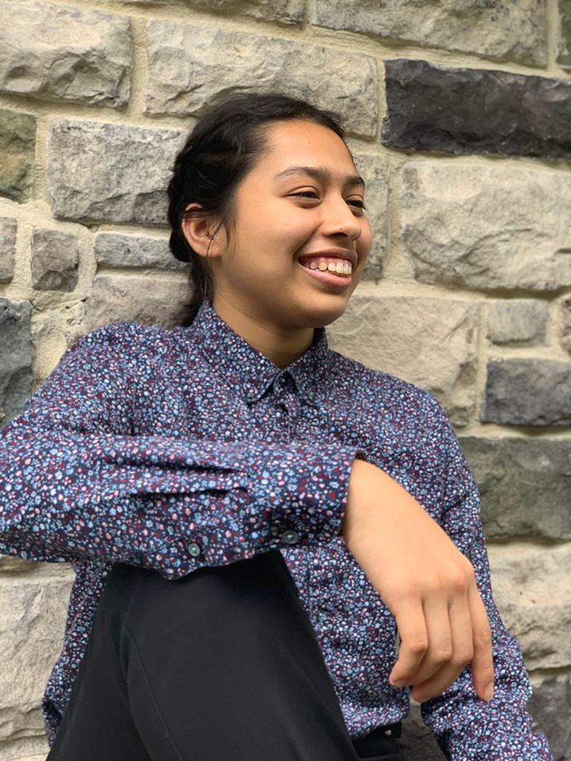
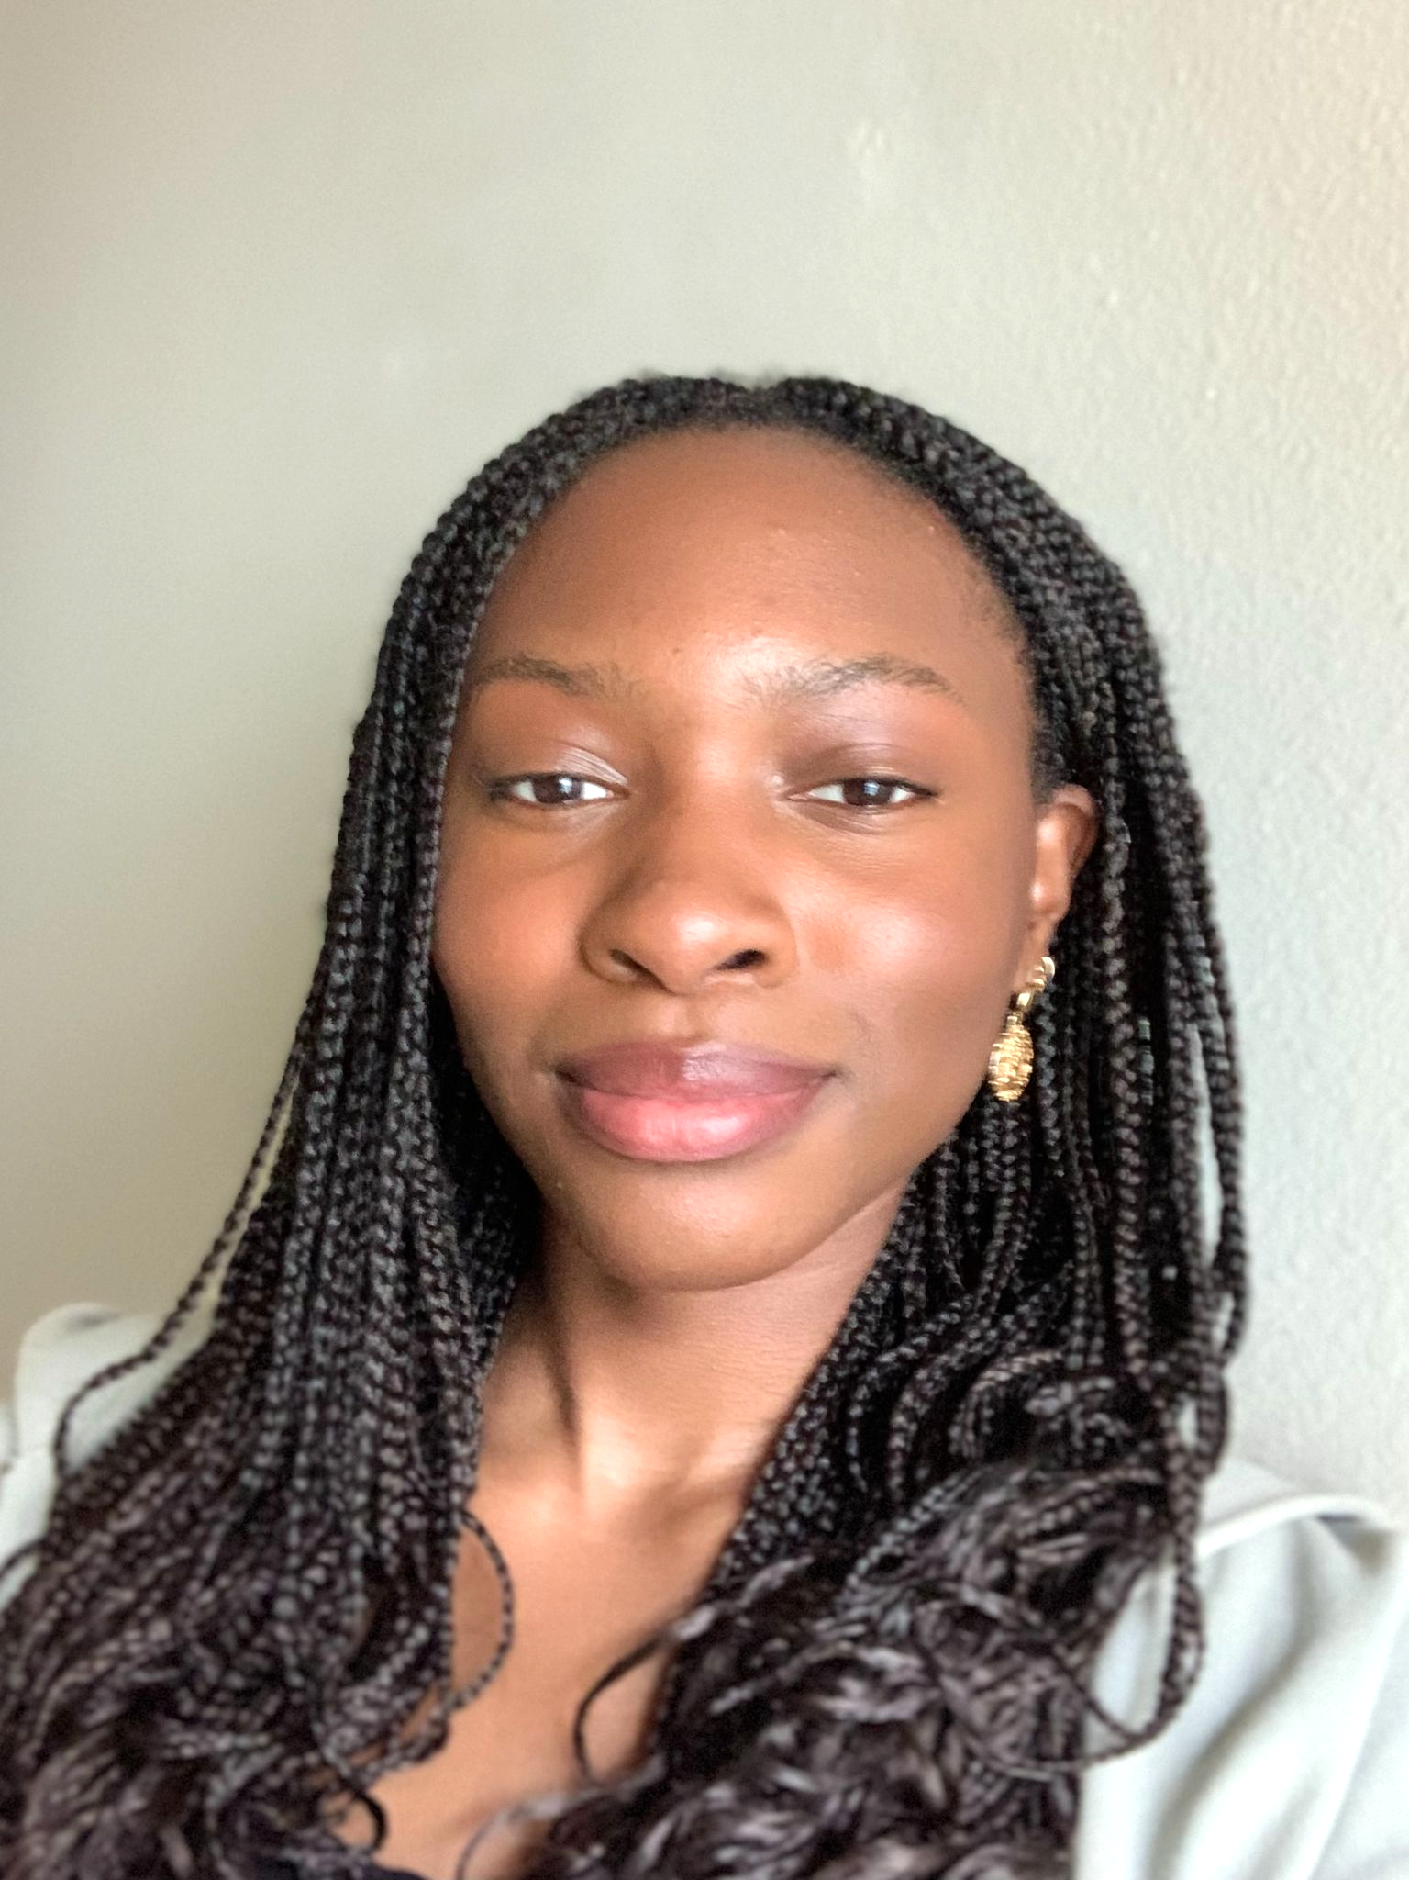
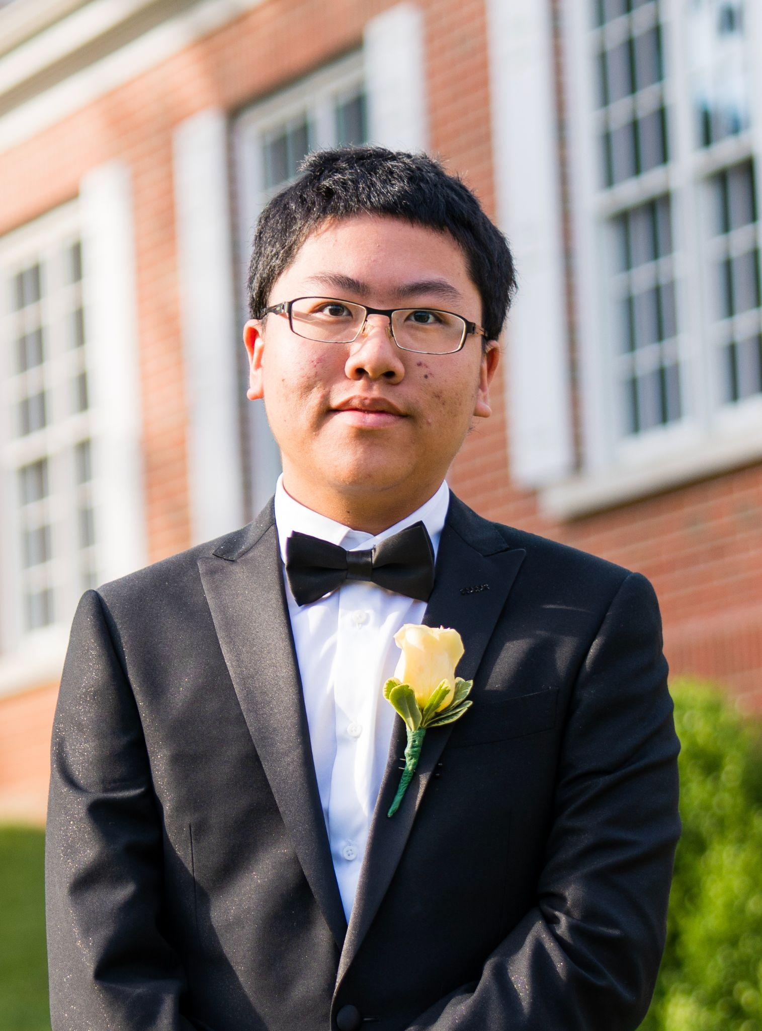
OUR TEAM
Mimi Olayeye
Brenda Cano
David Wei
Team Member
Team Member
Team member

Slide 4
PROBLEM VS OUR SOLUTION (elevator pitch)
PROBLEM
SOLUTION
Returning from a pandemic, Emory University hasn’t quite figured out all the best systems yet. Coordinating a consistent student experience of classes and dining has yet to be achieved. Dining options are in flux and unclear.
An app that does all the thinking for you. Get notified when your favorite meals are served or when other friends are available to eat. Coordinate seating locations by viewing a heatmap of locations and see capacity statistics to beat rush hour and dine at the safest time.
Notes:
Brenda

Slide 5
01
What did we accomplish?
Notes:
Brenda

Slide 6
Logo
Why was it created?
Increase professionalism
Show unity with our team
Notes:
Brenda

Slide 7
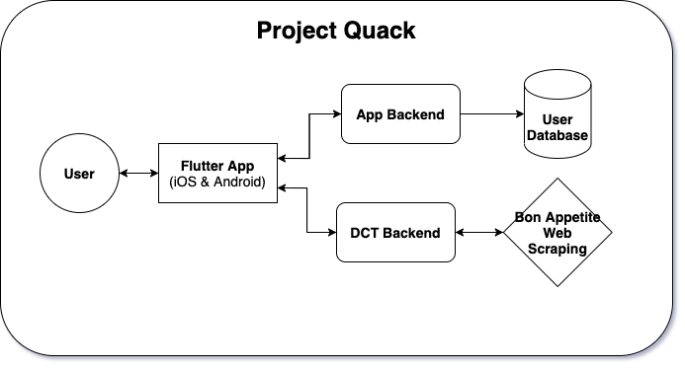
Established App Architecture
Notes:
Rafael

Slide 8
Setup Project Logistics
GitHub:
Setup Project Repository
Setup “Projects” Board
Setup Actions to automate certain tasks like (stories, deployment, continuous integration, code coverage)
Setup Issue Templates to normalize tickets added to the Product Backlog
Slack:
Setup & Organized Team Communication
Added Taco Bot to encourage team feedback and positivity
Added GitHub Bot to stay connected and informed on GitHub Activity
Heroku:
Setup Staging and Production Deployment backends
Notes:
Rafael

Slide 9
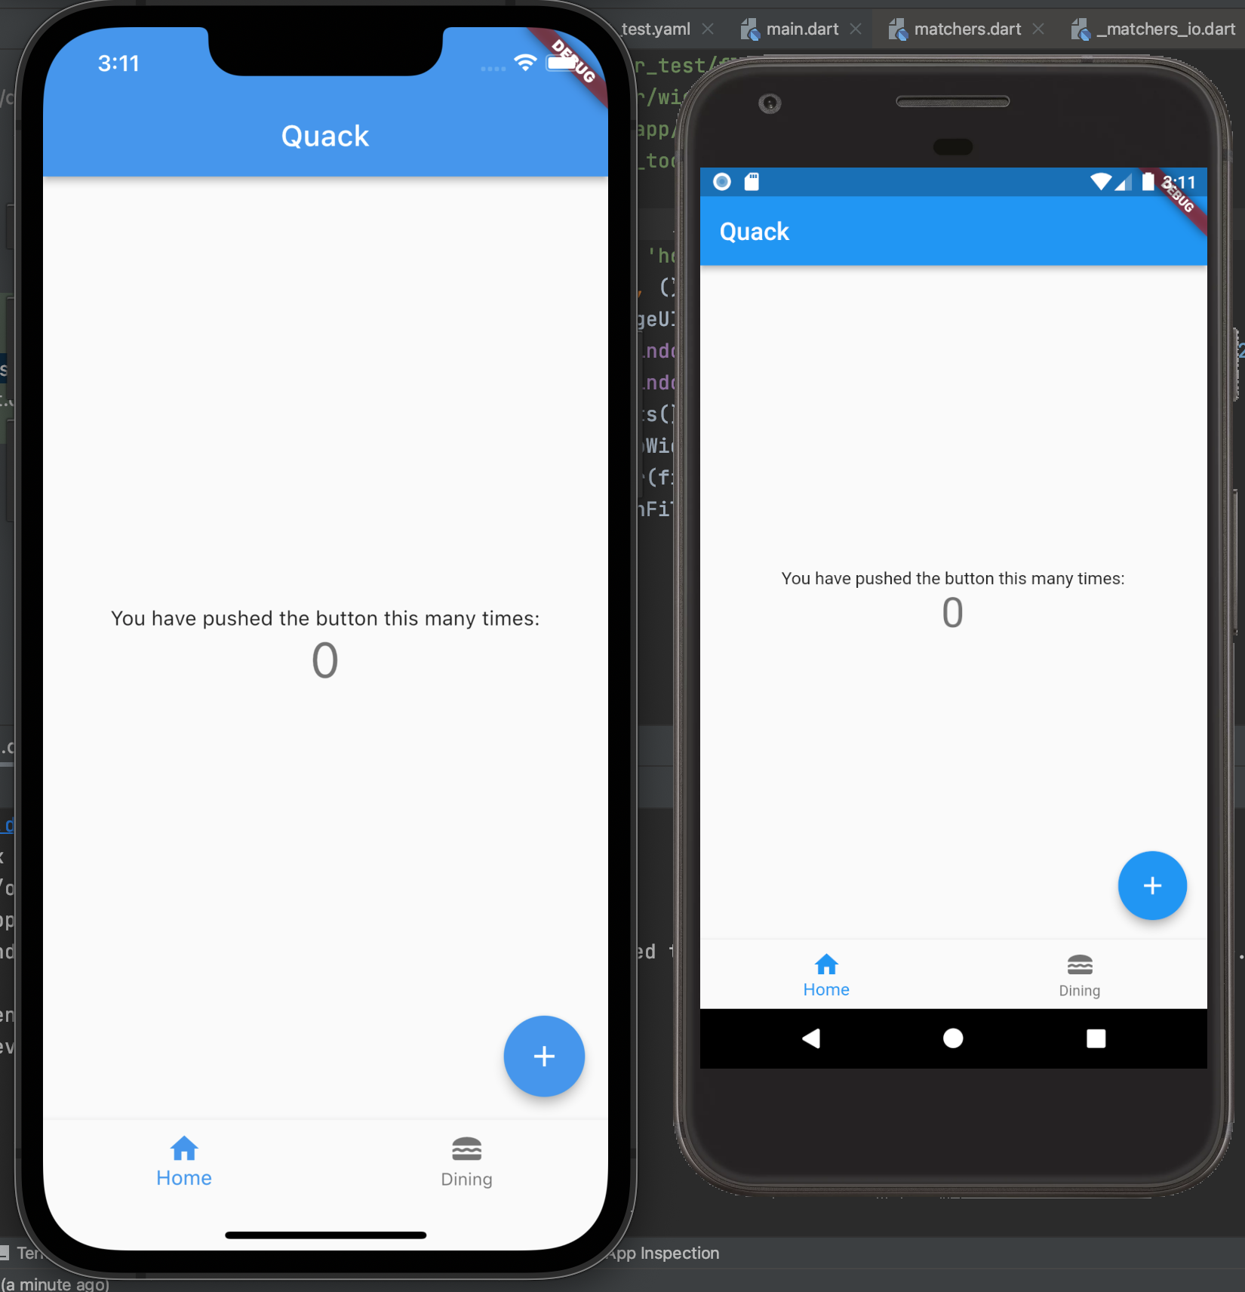
Hello World!
App
Designing the app with Flutter
Using Flutter to create a mobile app with Android and IOS compatibility
Finished a first basic app
Deployed Golden Tests for better UI testing
Notes:
David else

Slide 10
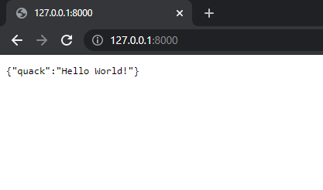
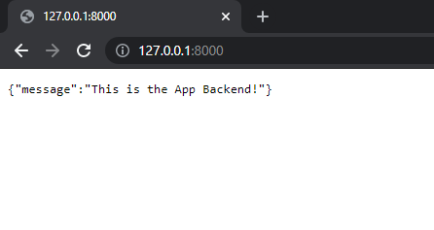
Hello World!
DCT Backend
Backends
Implemented basic “/” route for DCT and App backend
Implemented unit tests for both as well
App Backend
Notes:
Rafael and Ore

Slide 11
02
Acknowledging Feedback
Notes:
Brenda

Slide 12
Too long
Not project-centered
Confusing
Mission Statement
Need to break down what we want to do
Have a more specific focus
Need user personas
Idea is relevant for college students
Liked our motivation for this project
Overall Idea
Features
Unclear
Too many
What exactly will be in the app?
Notes:
Brenda

Slide 13
MISSION STATEMENT
Bestagons is a 6-person team of Emory Students working to improve the dining experience in the DCT. Through convenient features and COVID statistics, students will never have to think twice about dining again.
Notes:
Brenda

Slide 14
User Personas
Persona 1:
Mary is a Freshman majoring in Chemistry. She has a busy schedule and finds it hard to plan her meal times in between classes. She usually goes to lunch after her chemistry lab at 3:15, but the Dobbs Common Table (DCT) is always very full at that time, and she has another class at 4:00 that she can’t be late for.
Persona 2:
Mark is a Sophomore majoring in Anthropology. He recently became a pescitarian and has been loving salmon lately. However, he has missed the DCT’s Mediterranean Salmon three weeks in a row (such a bummer!). Additionally Mark’s best friend is a busy CS major, so finding time to dine together is a challenge.
Negative Persona:
Mario is a Senior double majoring in Music/Econ. They only have two classes this semester so their schedule is very relaxed. Mario is no longer on the Emory meal plan, because they live off campus. Every friday Mario and their roommates meal prep to organize their meals in advanced.
Notes:
Mimi

Slide 15
User Stories
As a <new Emory freshman> I want to <know where the foods are located> so that <I don’t waste time in between classes>
As a <gluten-free vegan> I want to <see all of the GF/vegan options the Dobbs Common Table (DCT) is offering> so that <planning my meal is stress free>
As a <busy English major> I want to <find time to eat with my friends> so that <I don’t have to keep making When2Meets for my friend group>
As a <visiting guest speaker> I want to <know what foods are being served> so that < I can plan my meal in advanced>
As an <immunocompromised student> I want to <know when the DCT isn’t too full> so that <I can be COVID safe while dining>
Notes:
Mimi

Slide 16
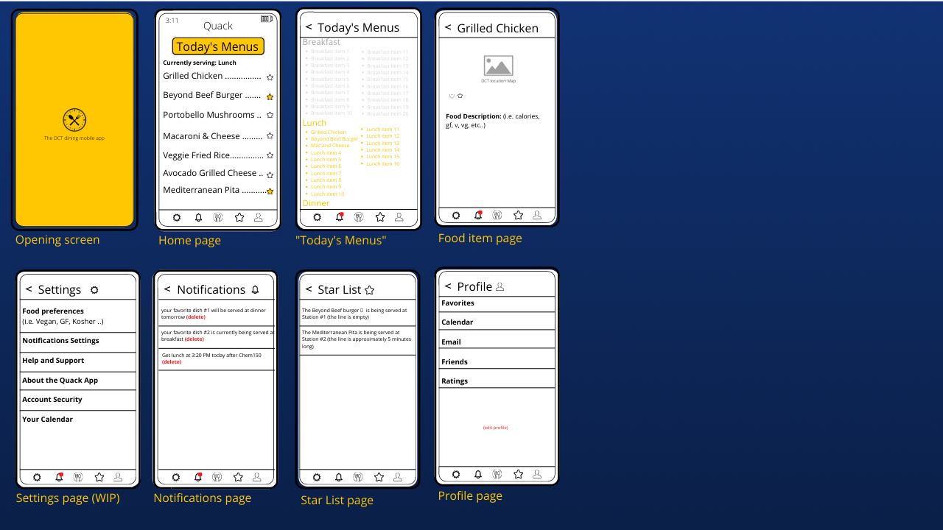
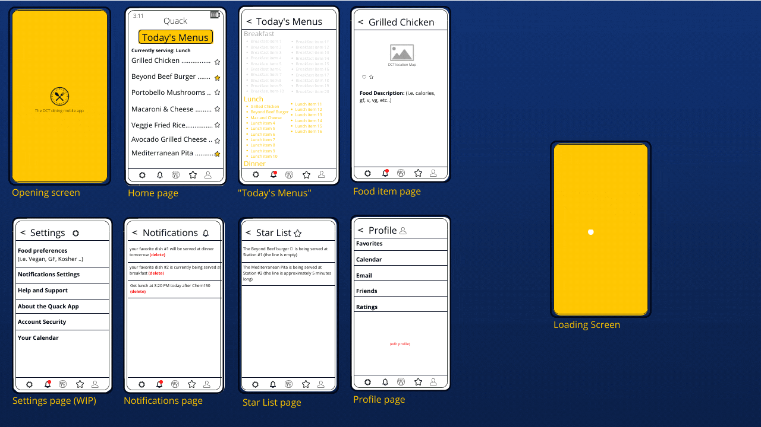
Paper
Prototype
Notes:
Mimi

Slide 17
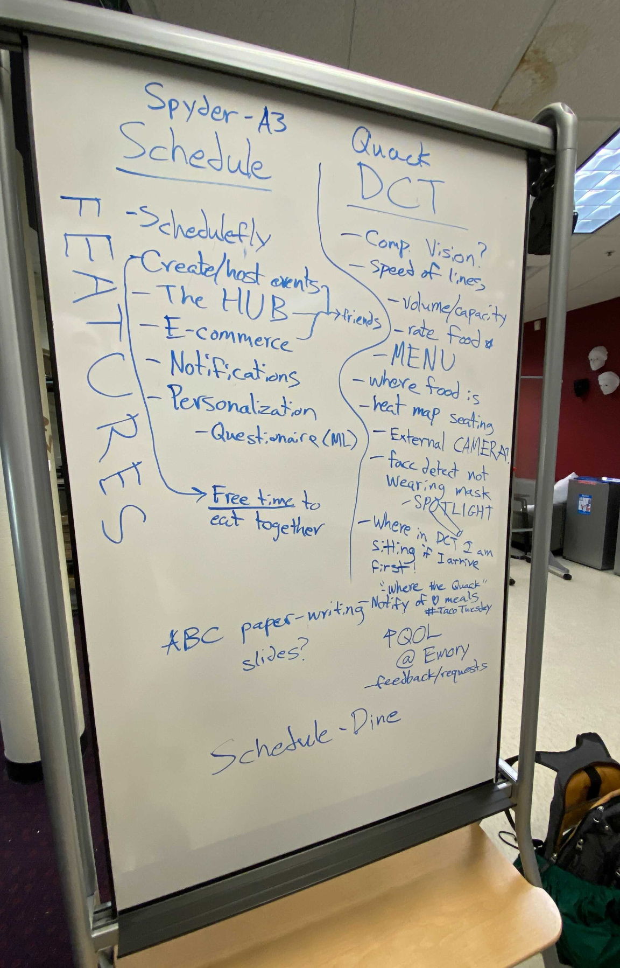
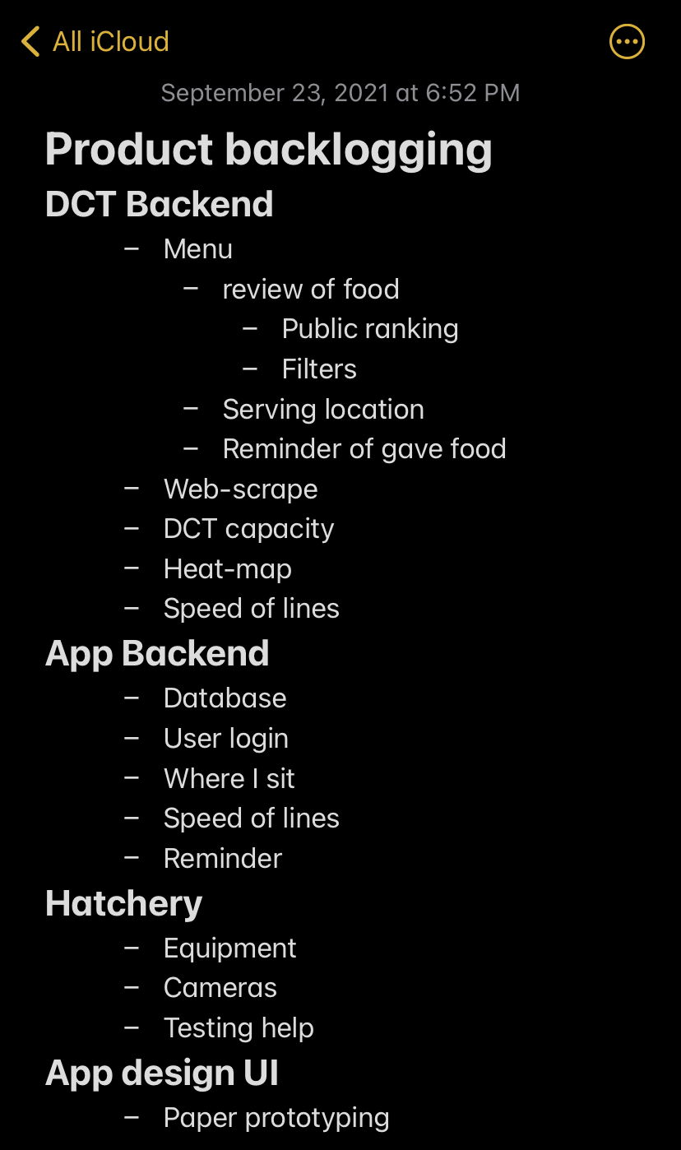
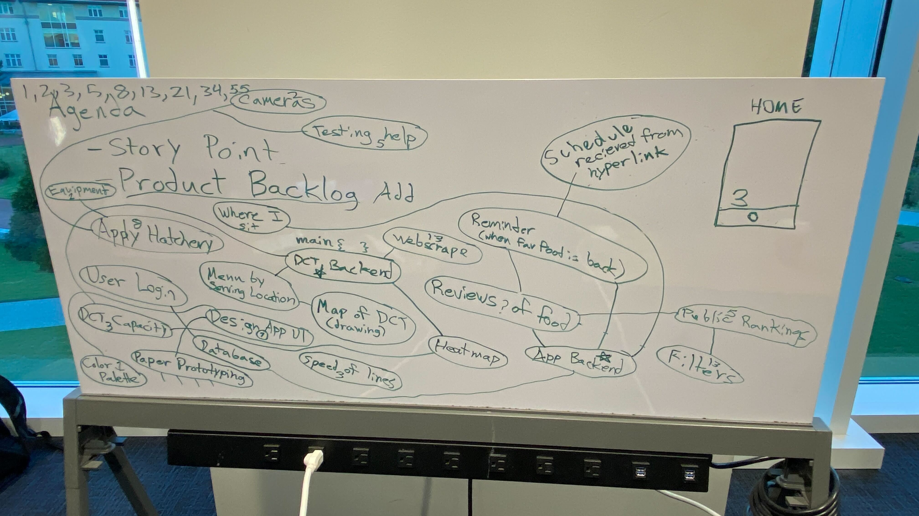
Our Features - Brainstorming
09/17/2021
Notes:
Miles: Last week it seemed to other groups that our features were unclear and confusing, and we understand why. As we solidified our features this week we would like to present a more accurate account of what we brainstormed.

Slide 18
Our Features - Solidified
Dining
List food options for the day
Directions to dining stations
Get notified for meal periods
Get notified for favorites
Review and rank food options
Coordinates eating times with friends for you
Dining w/ COVID
View dining hall capacity*
View a heatmap of student seating*
View estimated line length for stations
See capacity / heatmap data over time to make informed decisions on the safest time/place to eat*
(*) features are currently planned to be mocked
Notes:
Miles

Slide 19
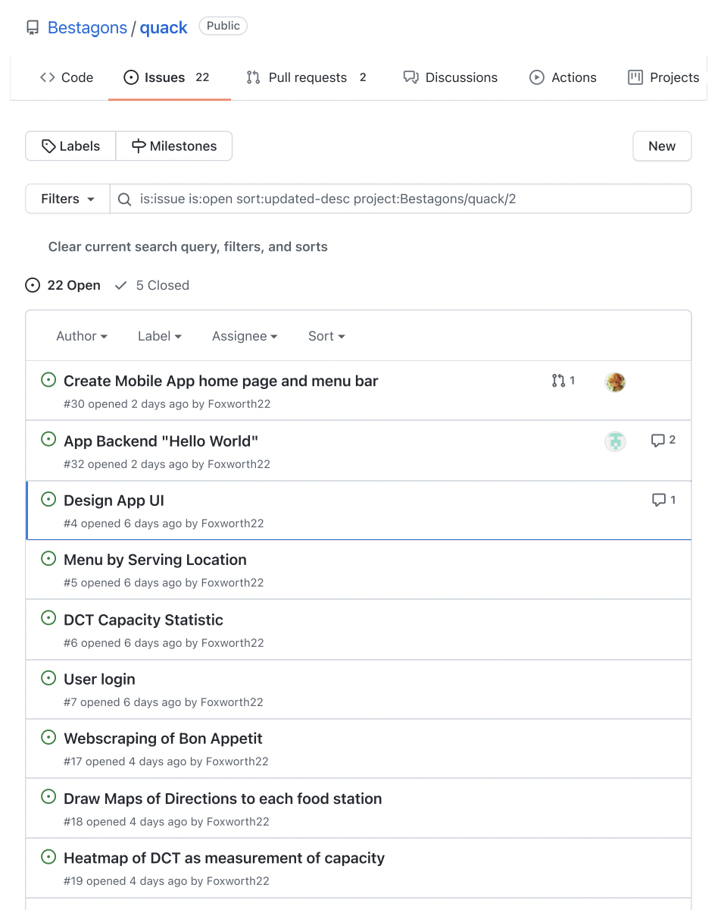
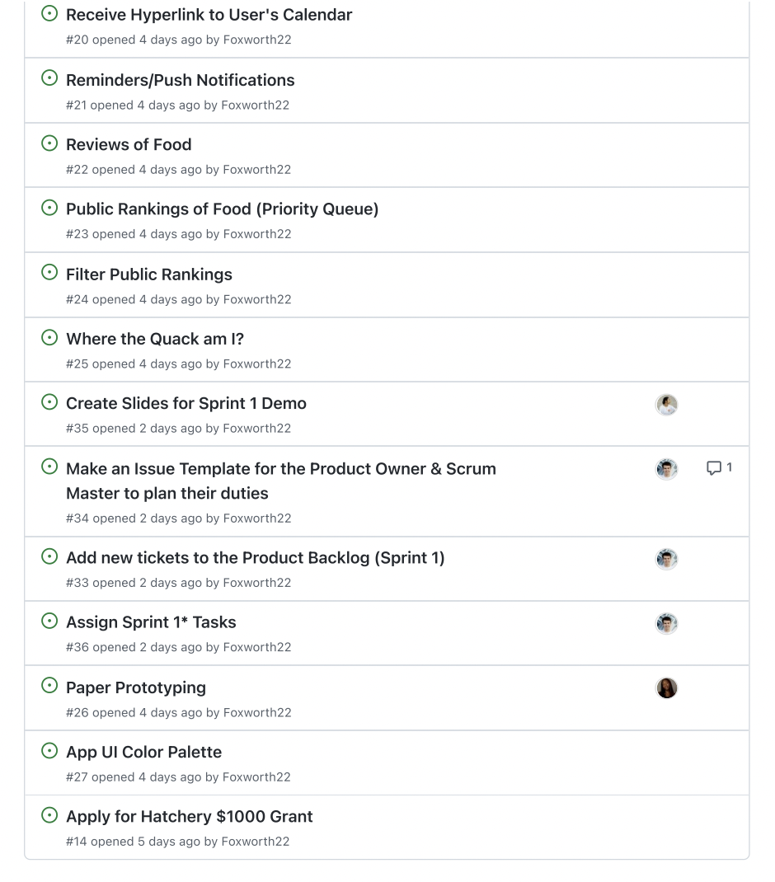
Our Features - GitHub
Using GitHub Issue Templates, I added our brainstorming into the Product Backlog
“Issues” for GitHub is akin to “Tickets” for Scrum
Notes:
Miles

Slide 20
03
What are our goals for the week?
Notes:
Miles

Slide 21
Goals
Start all Scrum meetings on time
If we need to move up a meeting time, it requires unanimous decision
Plan Sprint 2 after class today
09/17/2021
Notes:
Miles

Slide 22
THANKS
Please remember to share your feedback :)

